Slide 1
Adjusting the
Accounts

Slide 2

Timing Issues
Accountants divide the economic life of a business into artificial time periods (Time Period Assumption).
. . . . .
Jan.
Feb.
Mar.
Apr.
Dec.
Generally a month, a quarter, or a year.
Fiscal year vs. calendar year
Also known as the “Periodicity Assumption”

Slide 3
Timing Issues
Review
The time period assumption states that:
a. revenue should be recognized in the accounting period in which it is earned.
b. expenses should be matched with revenues.
c. the economic life of a business can be divided into artificial time periods.
d. the fiscal year should correspond with the calendar year.

Slide 4
Timing Issues
Accrual- vs. Cash-Basis Accounting
Accrual-Basis Accounting
Transactions recorded in the periods in which the events occur
Revenues are recognized when earned, rather than when cash is received.
Expenses are recognized when incurred, rather than when paid.

Slide 5
Timing Issues
Accrual- vs. Cash-Basis Accounting
Cash-Basis Accounting
Revenues are recognized when cash is received.
Expenses are recognized when cash is paid.
Cash-basis accounting is not in accordance with generally accepted accounting principles (GAAP).

Slide 6
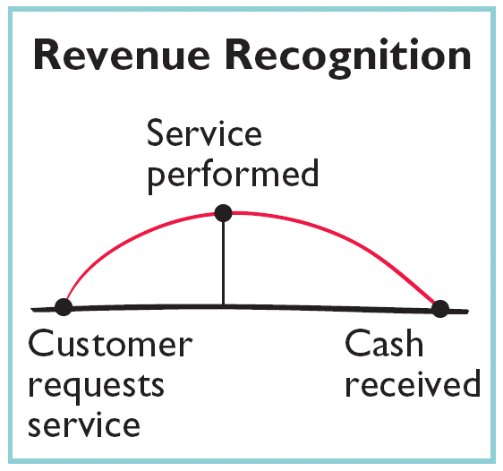
Timing Issues
Recognizing Revenues and Expenses
Revenue Recognition Principle
Companies recognize revenue in the accounting period in which it is earned.
In a service enterprise, revenue is considered to be earned at the time the service is performed.

Slide 7
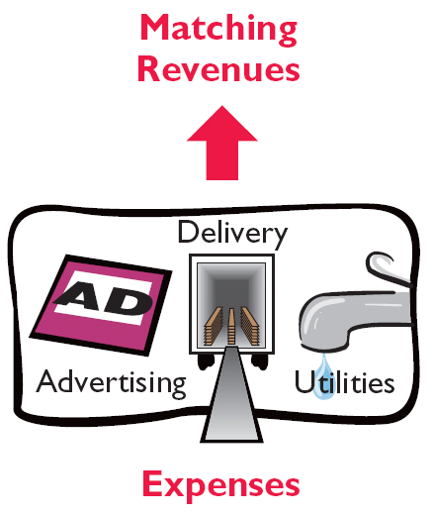
Timing Issues
Recognizing Revenues and Expenses
Matching Principle
Match expenses with revenues in the period when the company makes efforts to generate those revenues.
“Let the expenses follow the revenues.”

Slide 8
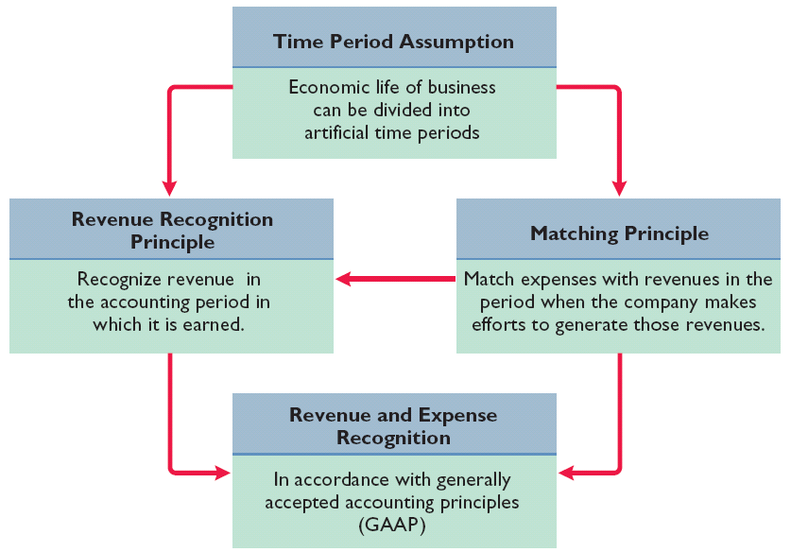
Timing Issues
GAAP relationships in revenue and expense recognition

Slide 9
Timing Issues
Review
One of the following statements about the accrual basis of accounting is false. That statement is:
  Events that change a company’s financial statements are recorded in the periods in which the events occur.
  Revenue is recognized in the period in which it is earned.
  The accrual basis of accounting is in accord with generally accepted accounting principles.
  Revenue is recorded only when cash is received, and expenses are recorded only when cash is paid.

Slide 10
The Basics of Adjusting Entries
Adjusting entries make it possible to report correct amounts on the balance sheet and on the income statement.
A company must make adjusting entries every time it prepares financial statements.

Slide 11
The Basics of Adjusting Entries
Revenues - recorded in the period in which they are earned.
Expenses - recognized in the period in which they are incurred.
Adjusting entries - needed to ensure that the revenue recognition and matching principles are followed.

Slide 12
Timing Issues
Review
Adjusting entries are made to ensure that:
a. expenses are recognized in the period in which they are incurred.
b. revenues are recorded in the period in which they are earned.
c. balance sheet and income statement accounts have correct balances at the end of an accounting period.
d. all of the above.

Slide 13
Types of Adjusting Entries
Illustration 4-2
Categories of adjusting entries
Deferrals
Accruals
1. Prepaid Expenses. Expenses paid in cash and recorded as assets before they are used or consumed.
3. Accrued Revenues. Revenues earned but not yet received in cash or recorded.
2. Unearned Revenues. Revenues received in cash and recorded as liabilities before they are earned.
4. Accrued Expenses. Expenses incurred but not yet paid in cash or recorded.

Slide 14
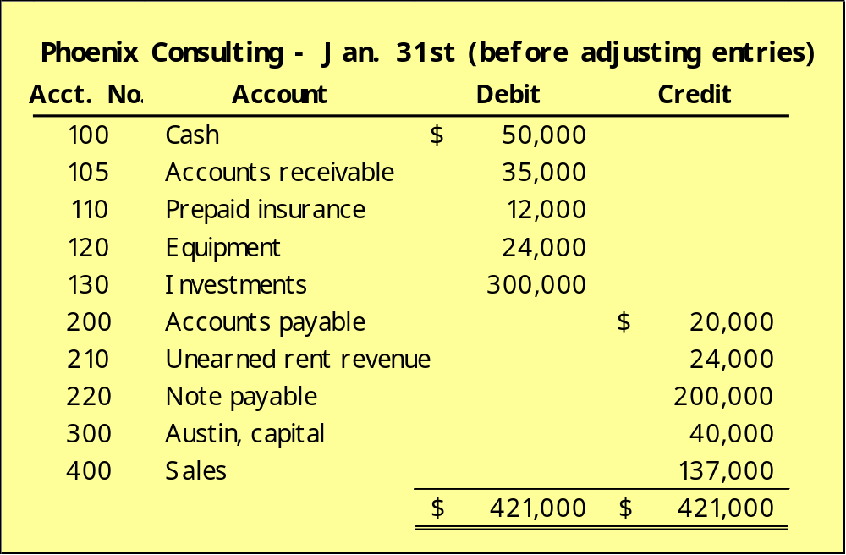
Trial Balance
Trial Balance – Each account is analyzed to determine whether it is complete and up-to-date.

Slide 15
Adjusting Entries for Deferrals
Deferrals are either:
Prepaid expenses
OR
Unearned revenues.

Slide 16
Adjusting Entries for “Prepaid Expenses”
Payment of cash, that is recorded as an asset because service or benefit will be received in the future.
Cash Payment
BEFORE
Expense Recorded
Prepayments often occur in regard to:
  insurance
  supplies
  advertising
  rent
  maintenance on equipment
  fixed assets (depreciation)

Slide 17
Adjusting Entries for “Prepaid Expenses”
Prepaid Expenses
Costs that expire either with the passage of time or through use.
Adjusting entries (1) to record the expenses that apply to the current accounting period, and (2) to show the unexpired costs in the asset accounts.

Slide 18
Adjusting Entries for “Prepaid Expenses”
Example (Insurance): On Jan. 1st, Phoenix Consulting paid $12,000 for 12 months of insurance coverage. Show the journal entry to record the payment on Jan. 1st.
Jan. 1
Prepaid Insurance
12,000
Cash
12,000
Prepaid Insurance
Cash
Debit
Credit
Debit
Credit
12,000
12,000

Slide 19
Adjusting Entries for “Prepaid Expenses”
Example (Insurance): On Jan. 1st, Phoenix Consulting paid $12,000 for 12 months of insurance coverage. Show the adjusting journal entry required at Jan. 31st.
Jan. 31
Insurance Expense
1,000
Prepaid Insurance
1,000
Prepaid Insurance
Insurance Expense
Debit
Credit
Debit
Credit
12,000
1,000
1,000
11,000

Slide 20
Adjusting Entries for “Prepaid Expenses”
Depreciation
Buildings, equipment, and vehicles (long-lived assets) are recorded as assets, rather than an expense, in the year acquired.
Companies report a portion of the cost of a long-lived asset as an expense (depreciation) during each period of the asset’s useful life (Matching Principle).

Slide 21
Adjusting Entries for “Prepaid Expenses”
Example (Depreciation): On Jan. 1st, Phoenix Consulting paid $24,000 for equipment that has an estimated useful life of 20 years. Show the journal entry to record the purchase of the equipment on Jan. 1st.
Jan. 1
Equipment
24,000
Cash
24,000
Equipment
Cash
Debit
Credit
Debit
Credit
24,000
24,000

Slide 22
Adjusting Entries for “Prepaid Expenses”
Example (Depreciation): On Jan. 1st, Phoenix Consulting paid $24,000 for equipment that has an estimated useful life of 20 years. Show the adjusting journal entry required at Jan. 31st. ($24,000 / 20 yrs. / 12 months = $100)
Jan. 31
Depreciation Expense
100
Accumulated Depreciation
100
Depreciation Expense
Accumulated Depreciation
Debit
Credit
Debit
Credit
100
100

Slide 23
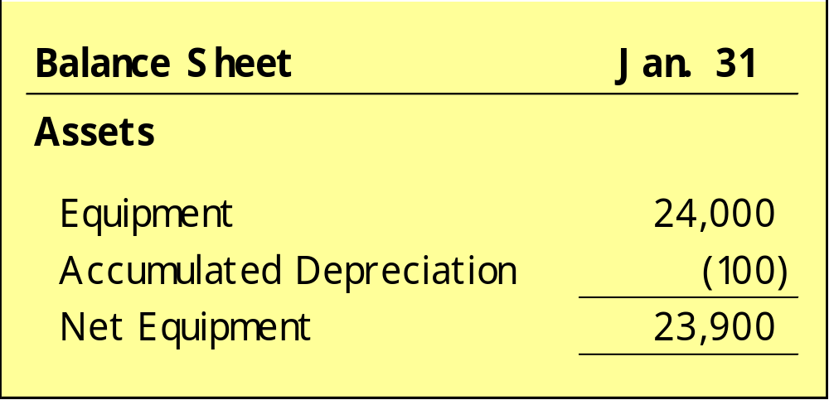
Adjusting Entries for “Prepaid Expenses”
Depreciation (Statement Presentation)
Accumulated Depreciation is a contra asset account.
Appears just after the account it offsets (Equipment) on the balance sheet.

Slide 24
Adjusting Entries for “Unearned Revenues”
Receipt of cash that is recorded as a liability because the revenue has not been earned.
Cash Receipt
BEFORE
Revenue Recorded
Unearned revenues often occur in regard to:
  rent
  airline tickets
  school tuition
  magazine subscriptions
  customer deposits

Slide 25
Adjusting Entries for “Unearned Revenues”
Unearned Revenues
Company makes an adjusting entry to record the revenue that has been earned and to show the liability that remains.
The adjusting entry for unearned revenues results in a decrease (a debit) to a liability account and an increase (a credit) to a revenue account.

Slide 26
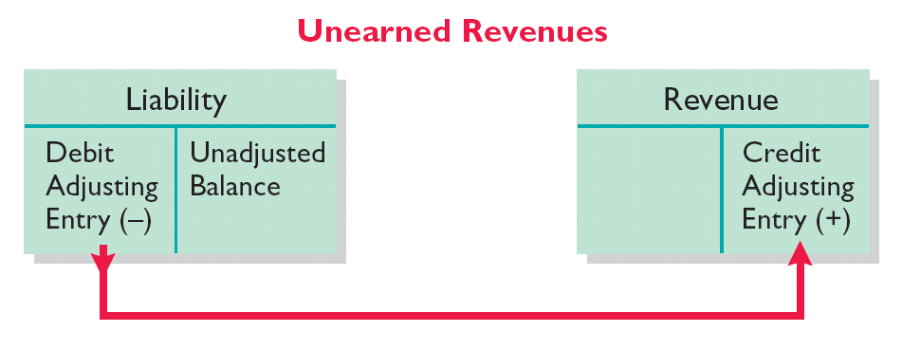
Adjusting Entries for “Unearned Revenues”
Adjusting entries for unearned revenues
Decrease (a debit) to a liability account and
Increase (a credit) to a revenue account.

Slide 27
Adjusting Entries for “Unearned Revenues”
Example: On Jan. 1st, Phoenix Consulting received $24,000 from Arcadia High School for 3 months rent in advance. Show the journal entry to record the receipt on Jan. 1st.
Jan. 1
Cash
24,000
Unearned Rent Revenue
24,000
Cash
Unearned Rent Revenue
Debit
Credit
Debit
Credit
24,000
24,000

Slide 28
Adjusting Entries for “Unearned Revenues”
Example: On Jan. 1st, Phoenix Consulting received $24,000 from Arcadia High School for 3 months rent in advance. Show the adjusting journal entry required on Jan. 31st.
Jan. 31
Unearned Rent Revenue
8,000
Rent Revenue
8,000
Rent Revenue
Unearned Rent Revenue
Debit
Credit
Debit
Credit
8,000
8,000
24,000
16,000

Slide 29
Adjusting Entries for Accruals
Made to record:
  Revenues earned and
  OR
  Expenses incurred
in the current accounting period that have not been recognized through daily entries.

Slide 30
Adjusting Entries for “Accrued Revenues”
Revenues earned but not yet received in cash or recorded.
Adjusting entry results in:
Revenue Recorded
BEFORE
Cash Receipt
Accrued revenues often occur in regard to:
  rent
  interest
  services performed

Slide 31
Adjusting Entries for “Accrued Revenues”
Accrued Revenues
An adjusting entry serves two purposes:
(1) It shows the receivable that exists, and
(2) It records the revenues earned.

Slide 32
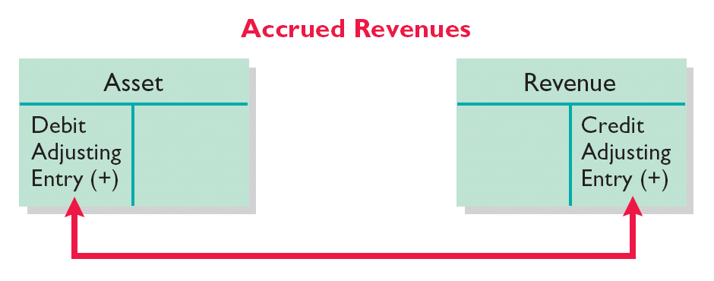
Adjusting Entries for “Accrued Revenues”
Adjusting entries for accrued revenues
Increases (debits) an asset account and
Increases (credits) a revenue account.

Slide 33
Adjusting Entries for “Accrued Revenues”
Example: On Jan. 1st, Phoenix Consulting invested $300,000 in securities that return 5% interest per year. Show the journal entry to record the investment on Jan. 1st.
Jan. 1
Investments
300,000
Cash
300,000
Investments
Cash
Debit
Credit
Debit
Credit
300,000
300,000

Slide 34
Adjusting Entries for “Accrued Revenues”
Example: On Jan. 1st, Phoenix Consulting invested $300,000 in securities that return 5% interest per year. Show the adjusting journal entry required on Jan. 31st. ($300,000 x 5% / 12 months = $1,250)
Jan. 31
Interest Receivable
1,250
Interest Revenue
1,250
Interest Receivable
Interest Revenue
Debit
Credit
Debit
Credit
1,250
1,250

Slide 35
Adjusting Entries for “Accrued Expenses”
Expenses incurred but not yet paid in cash or recorded.
Adjusting entry results in:
Expense Recorded
BEFORE
Cash Payment
Accrued expenses often occur in regard to:
  rent
  interest
  taxes
  salaries

Slide 36
Adjusting Entries for “Accrued Expenses”
Accrued Expenses
An adjusting entry serves two purposes:
(1) It records the obligations, and
(2) It recognizes the expenses.

Slide 37
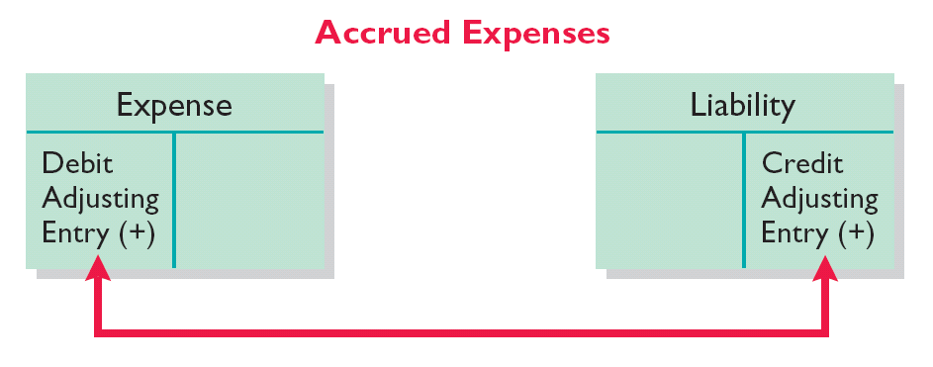
Adjusting Entries for “Accrued Expenses”
Illustration 3-16
Adjusting entries for accrued expenses
Increases (debits) an expense account and
Increases (credits) a liability account.

Slide 38
Adjusting Entries for “Accrued Expenses”
Example: On Jan. 2nd, Phoenix Consulting borrowed $200,000 at a rate of 9% per year. Interest is due on first of each month. Show the journal entry to record the borrowing on Jan. 2nd.
Jan. 2
Cash
200,000
Notes Payable
200,000
Cash
Notes Payable
Debit
Credit
Debit
Credit
200,000
200,000

Slide 39
Adjusting Entries for “Accrued Expenses”
Example: On Jan. 2nd, Phoenix Consulting borrowed $200,000 at a rate of 9% per year. Interest is due on first of each month. Show the adjusting journal entry required on Jan. 31st. ($200,000 x 9% / 12 months = $1,500)
Jan. 31
Interest Expense
1,500
Interest Payable
1,500
Interest Expense
Interest Payable
Debit
Credit
Debit
Credit
1,500
1,500

Slide 40
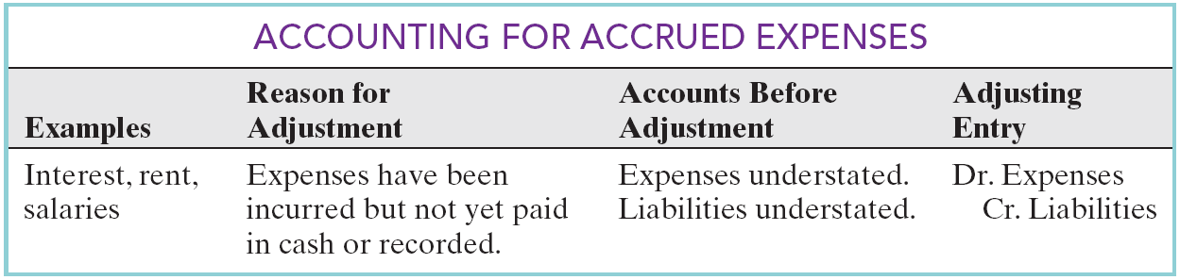
Adjusting Entries for “Accrued Expenses”
Summary

Slide 41
The Adjusted Trial Balance
After all adjusting entries are journalized and posted the company prepares another trial balance from the ledger accounts (Adjusted Trial Balance).
Its purpose is to prove the equality of debit balances and credit balances in the ledger.

Slide 42
The Adjusted Trial Balance
Review
Which of the following statements is incorrect concerning the adjusted trial balance?
  An adjusted trial balance proves the equality of the total debit balances and the total credit balances in the ledger after all adjustments are made.
  The adjusted trial balance provides the primary basis for the preparation of financial statements.
  The adjusted trial balance lists the account balances segregated by assets and liabilities.
  The adjusted trial balance is prepared after the adjusting entries have been journalized and posted.

Slide 43
Preparing Financial Statements
Financial Statements are prepared directly from the Adjusted Trial Balance.
Balance Sheet
Income Statement
Owner’s Equity Statement

Slide 44
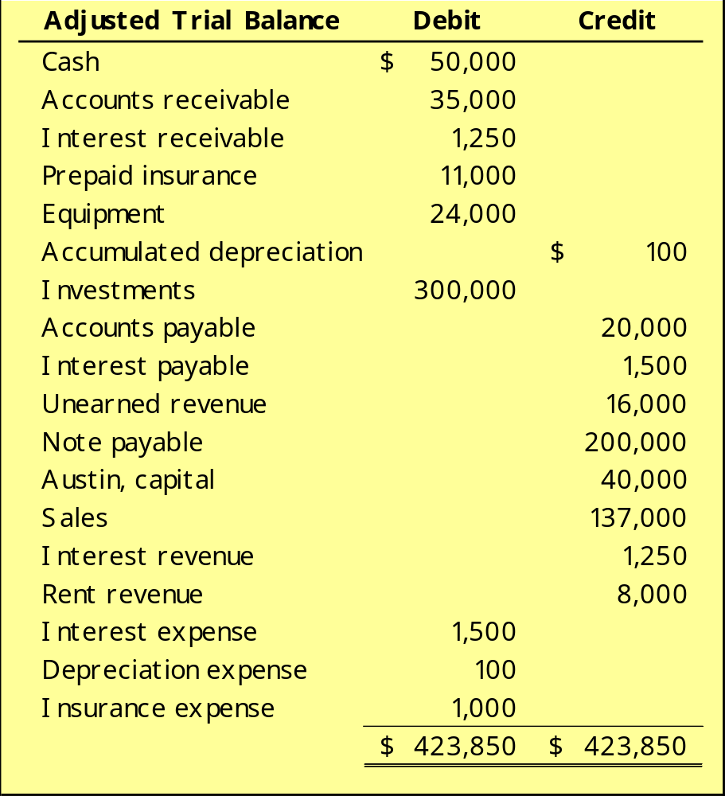
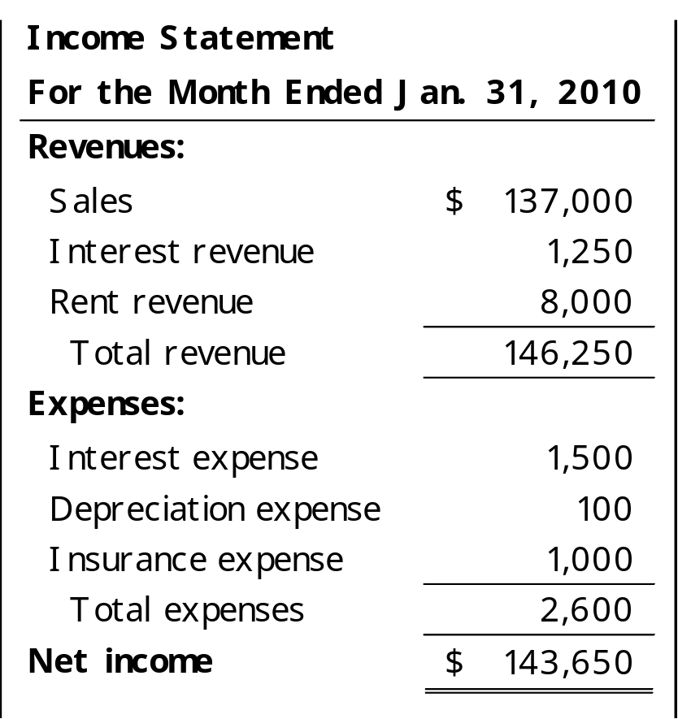
Preparing Financial Statements
Income Statement

Slide 45
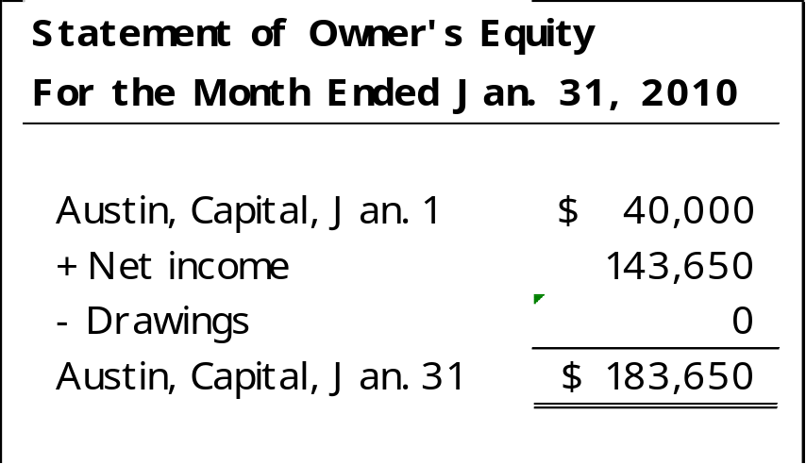
Preparing Financial Statements
Statement of Owner’s Equity

Slide 46
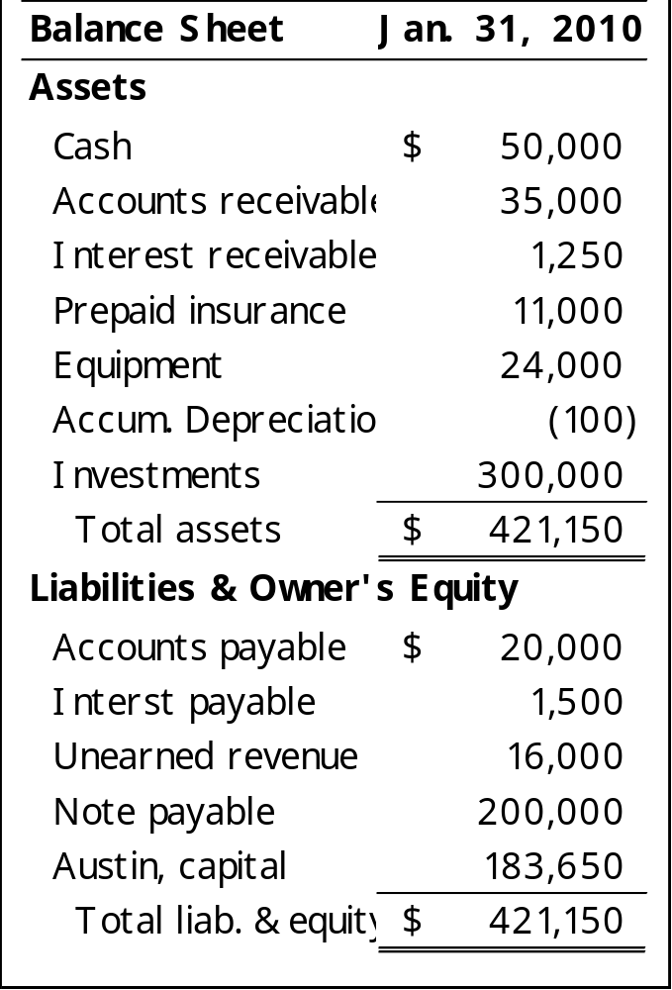
Preparing Financial Statements

